Slide 1


Project: Games Arcade Management System
Project Members
Sukhdeep singh (4540448)
Kuldeep kaur(4535743)
Jatin dang(4535620)
Himanshu Himanshu(4547157)
Date of presentation: 14/10/2024

Slide 2
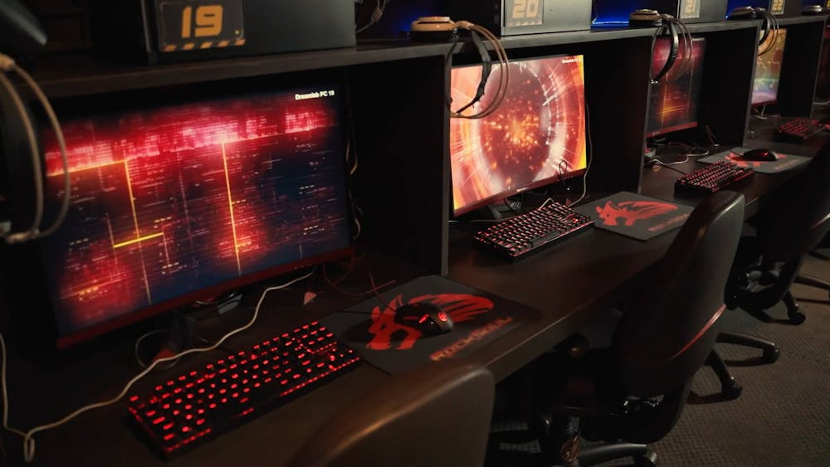
AGENDA:
An overview of the presentation structure
* Customer management
* Real-time financial tracking and report ine and bug tracking tools used
Issue and bug tracking tools used
* Full overview of JIRA or trolls which are used for
issue and bug tracking
* explain the features how every tools work on
the project
Workflow
* Full details of the workflow developed
* issue tracking
* resolving and transitioning
Integrations with other tools
* improve team cooperation and streamline
process
* proliferating the functionality
Resource allocation and workload balancing
*ideas for productivity
* avoid burnout
* explain the main techniques

Slide 3
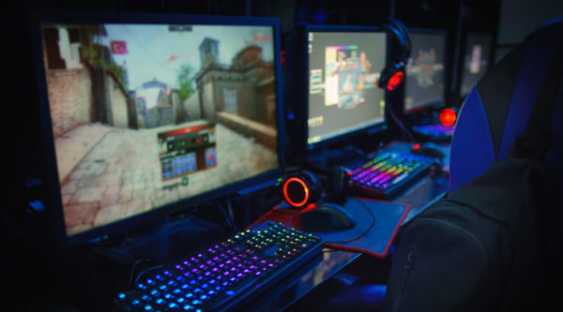
Summary
* overview of the presentation
* discuss all the main features
Questions
* open the floor for discussion
* feedback receive from the audience
This Photo by Unknown Author is licensed under CC BY-SA-NC

Slide 4

Issue and bug racking tools
For issue and bug tracking tools we give preference to JIRA. Because JIRA is more useful as compared to others effective tool. It is user-friendly tool. It has great features and functionalities.
Key Features
Issue Tracking: it supports lot of problems like bugs, epics and tracks.
Automation: its is automatically assigned the tasks to the people which helps to reduce the manual work.
Backlog Management: it also manage the backlog of tasks and issues.
This Photo by Unknown Author is licensed under CC BY-SA

Slide 5

Workflow
start
Create: a new issue is created
TO Do: signifies the issue that has been ready to be worked on.
Done: all work is associated with issue or bug report is completed.
IN Progress: Team member still working on a issue
j

Slide 6
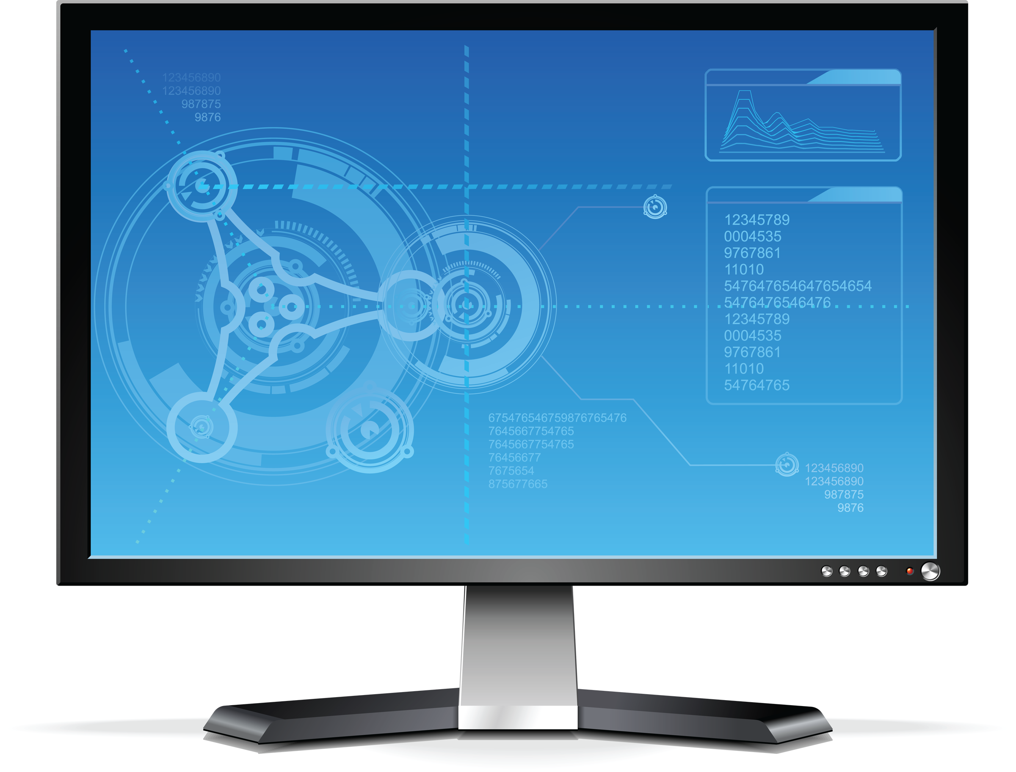
Integration with other tools
we use GitHub for connecting the whole code repository with project management in JIRA. It is also useful for project tracking activity and linking the specific issue in JIRA.
GitHub is also important for increasing automation, collaborations and productivity.
GitHub integrated with JIRA very easily and provide us a better result of our project planning which improves not only improves the team cooperation it also enhance the individually productivity.

Slide 7

Re
Resource Allocation and work Balancing
We use JIRA and GitHub tool for managing our resource and work balancing.
We also do deeply search on each and every aspect of our presentation by regular communication and we also divide our work individually which help us to make our project more productive.
JIRA represents that how much work is done by each member and if one person do lot of work then we assigned the task equally.
GitHub is more powerful tool by which we tracked the issue and also put a pull request for changing the repository and we do all changes which are important before it merged the task into the main branch.
This Photo by Unknown Author is licensed under CC BY-SA-NC

Slide 8
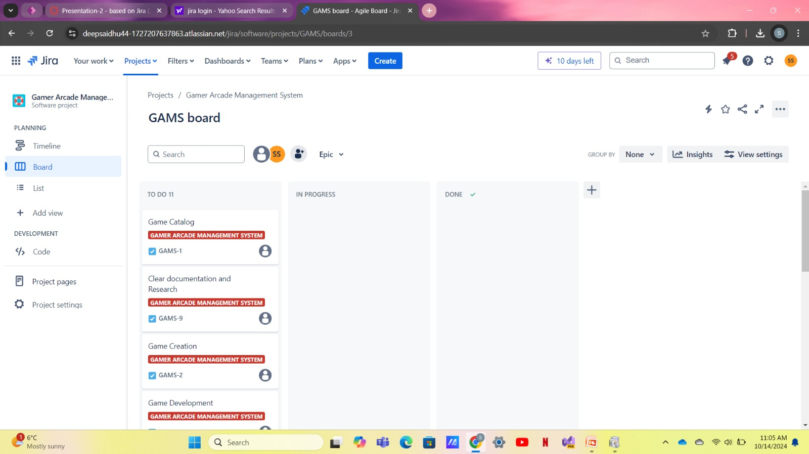

Resource Allocation and Work Balancing

Slide 9
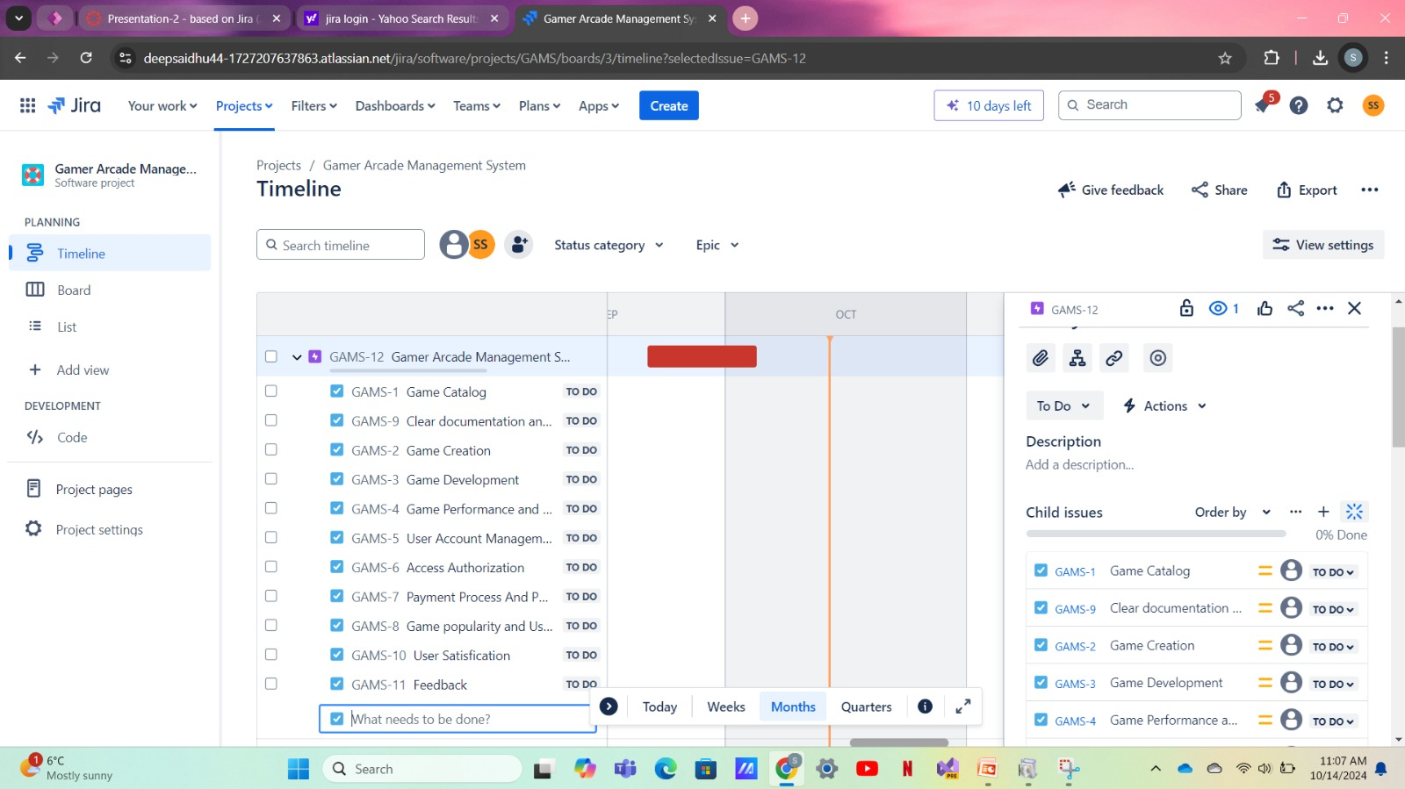

This Photo by Unknown Author is licensed under CC BY-SA

Slide 10
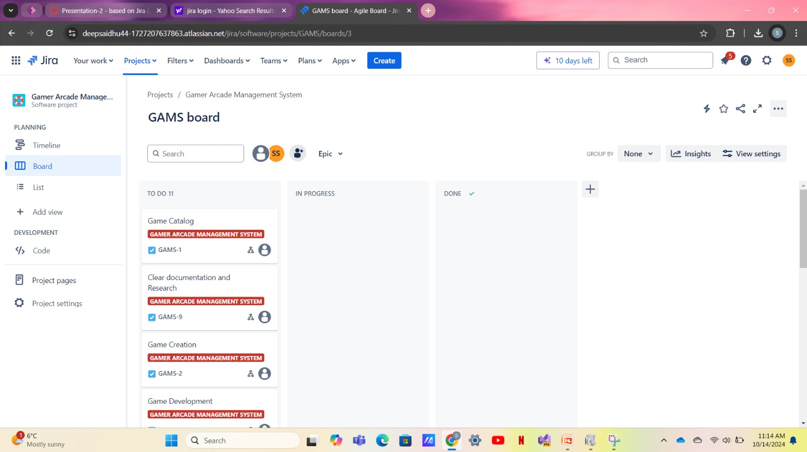

Slide 11
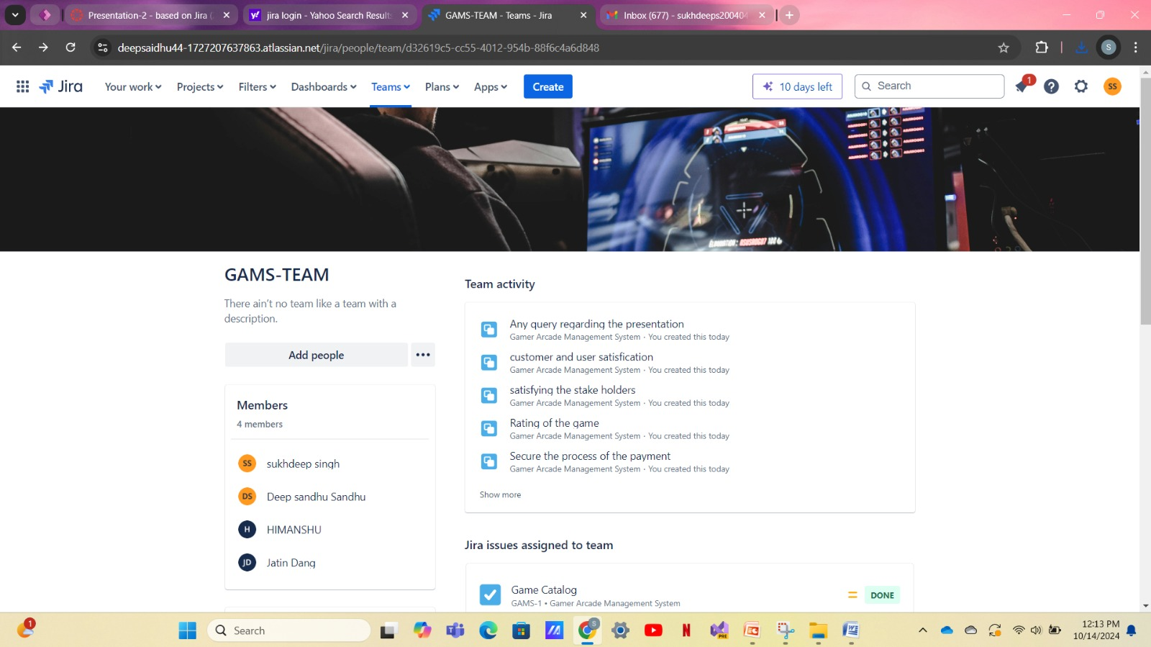

Slide 12
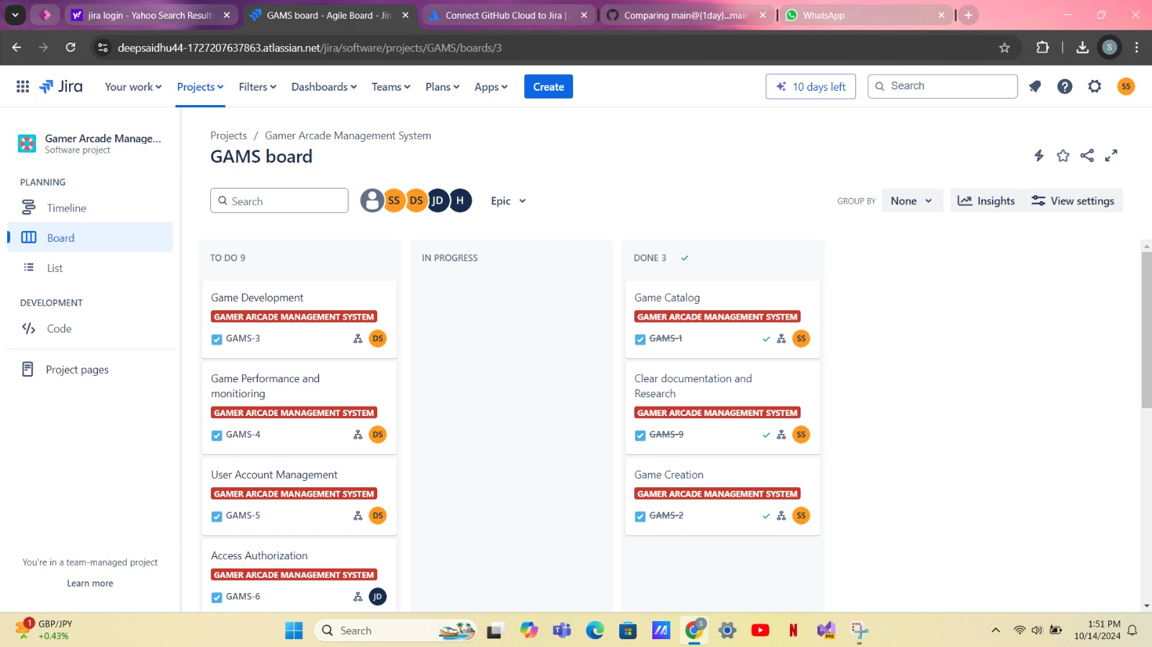

Slide 13
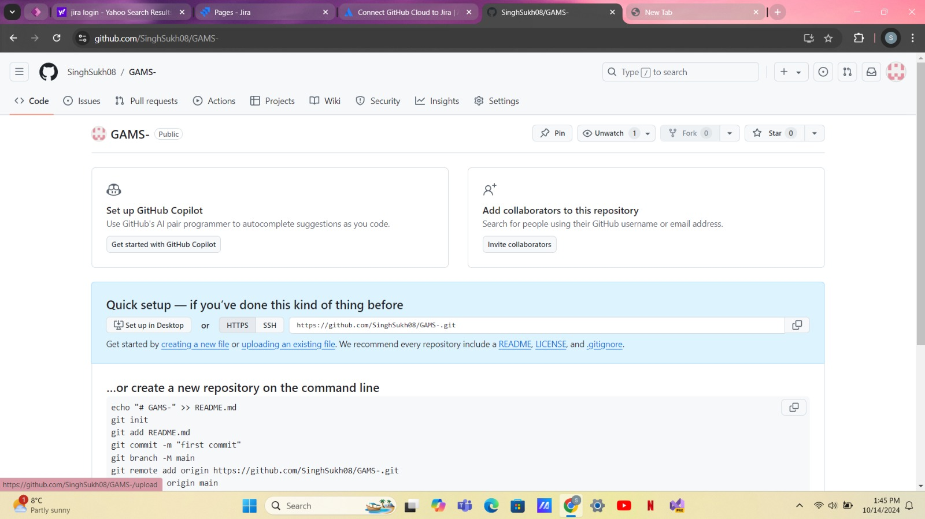

Slide 14
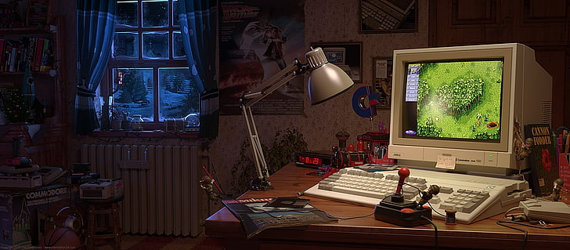
Summary
To summarize that JIRA is very helpful tool because it helps to track, create an issue and bugs.
By integration of JIRA with GitHub linked the code with project which inclined the development workflow.
This integration also helps to decrease the manual tracking and allows team members to focus on the development only.

Slide 15


Slide 16
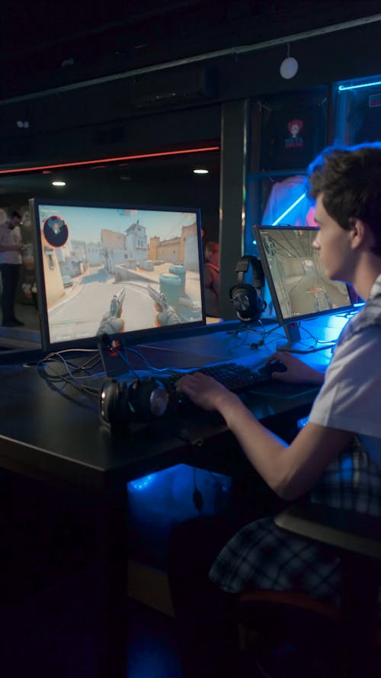
References
Atlassian support – support.Atlassian.com
GitHub Docs – docs.github.com/ https://github.com
Cite GitHub repositories – academiainsider.com / DR. Andrew Stapleton

Slide 17

This Photo by Unknown Author is licensed under CC BY-SA

